Slide 1




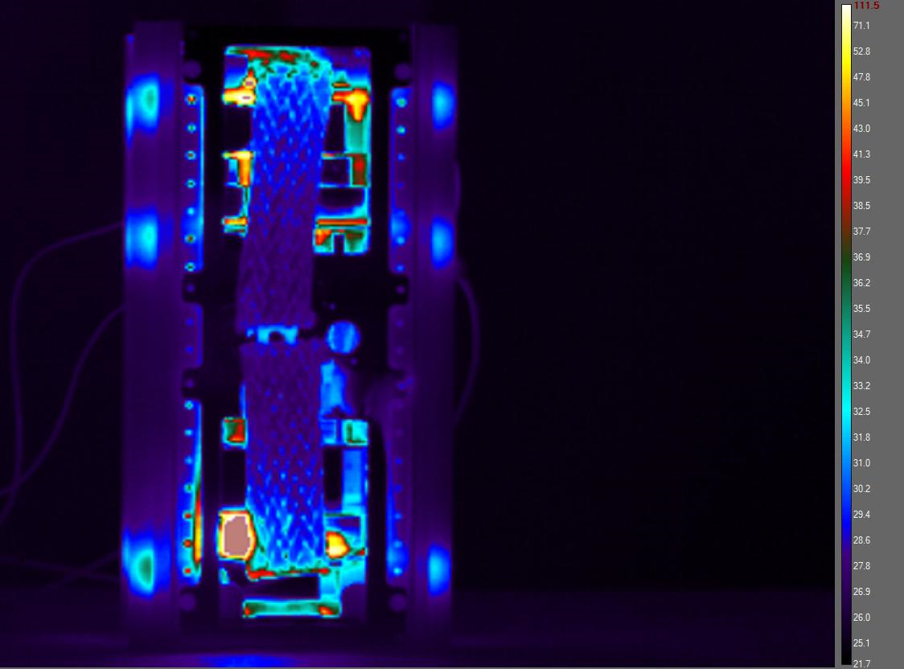
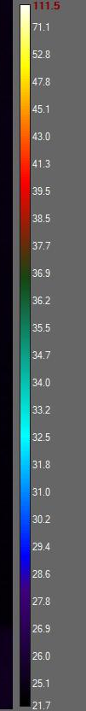
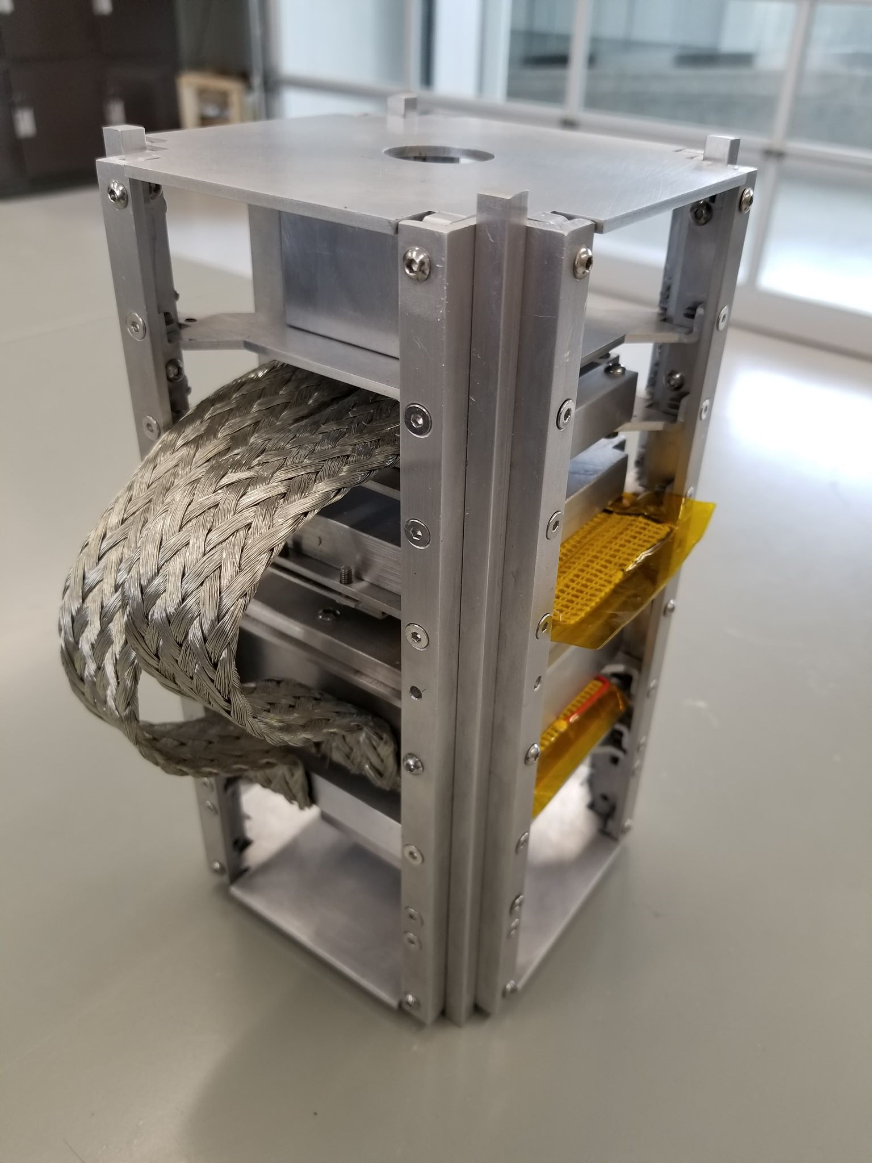
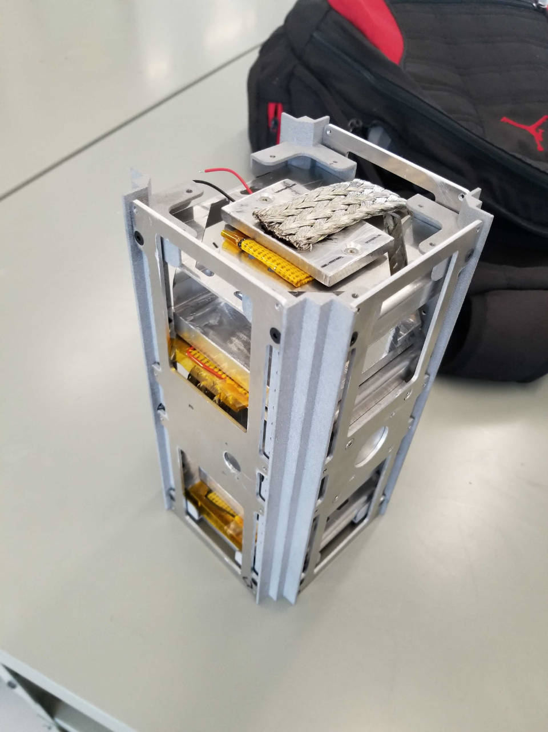
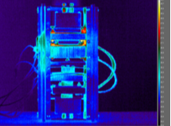
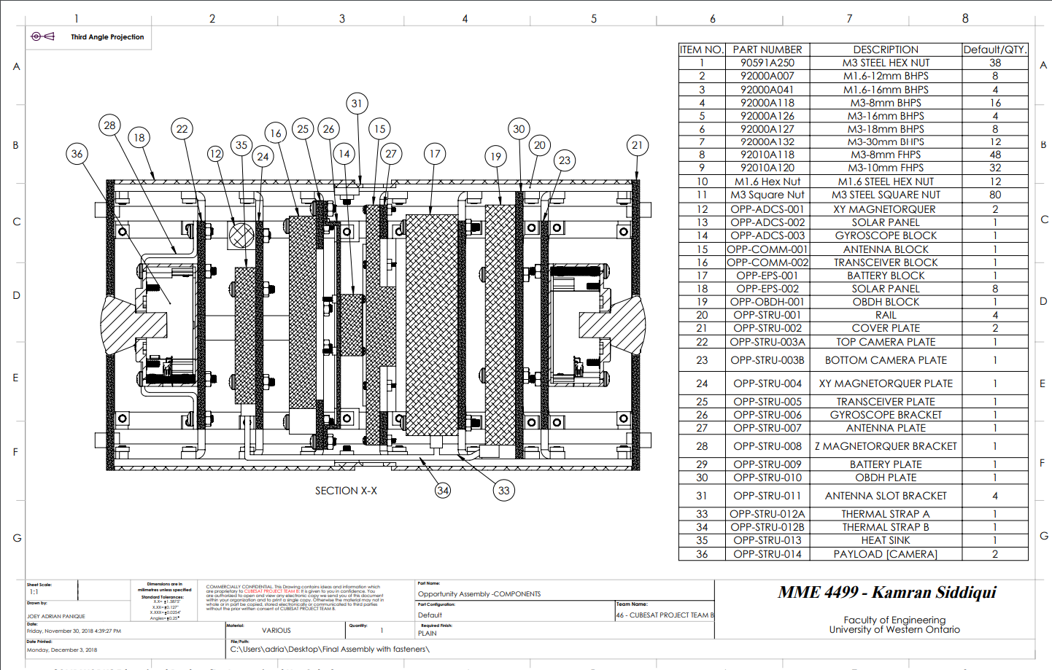
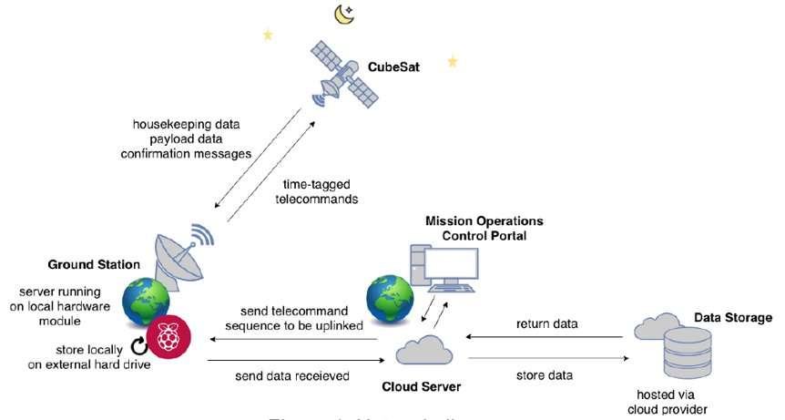
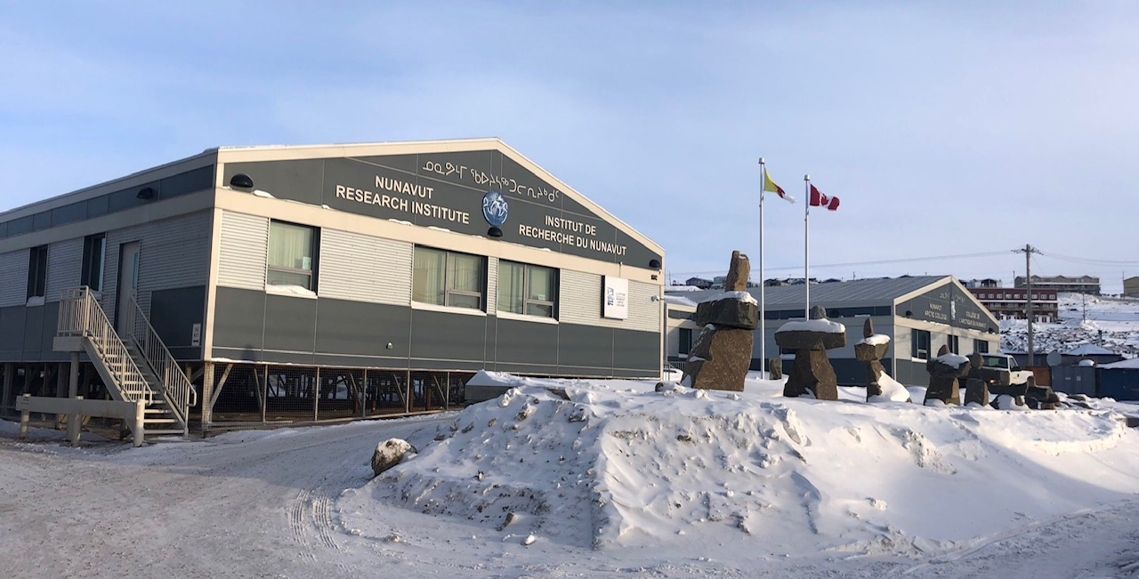
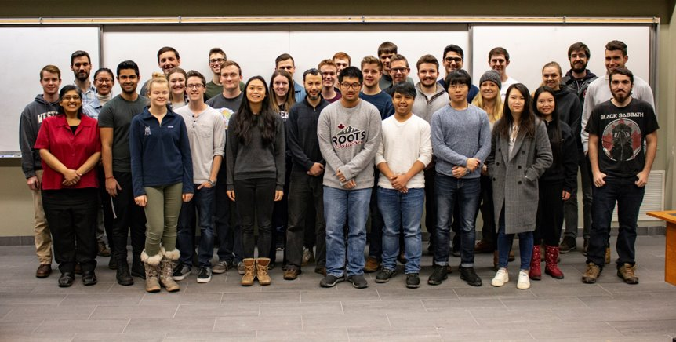




Western University – Nunavut Arctic College CubeSat Mission
OUR MISSION
TRADE-OFF STUDY
Provide experiential learning and training opportunities for students in spacecraft development and operations, and in STEM outreach program development and delivery.
Integrate and operate the in kind contribution of two Canadensys Nano VR cameras in orbit for space and education.
A trade-off study was performed where two independent designs were developed based on different communications methods: S-band and ultra high frequency (UHF) band. The systems affected by study were the structure/thermal system, the power system, the communications system, and the ground station.
The trade-off study also gave opportunity for more students to participate in the Western University-Nunavut Arctic College CubeSat mission. The UHF design had key benefits of: available parts, cost, lesser antenna pointing requirements and requires less power to operate. The S-band’s design main benefit is its higher data rate.
Specification | Value
Field of View | 190°/2π sr.
Size | 50 x 50 x 50 mm
Mass | 150 g
Resolution (avg) | 0.07°/pixel
Image size | 13.5 MB
Video | 1080p @ 30 fps
CUBESAT BUS
S-band design
UHF design
UHF design
S-band design
OPERATIONS PLAN
WESTERN UNIVERSITY – NUNAVUT ARCTIC COLLEGE COLLABORATION
CURRENT STATUS
The University of Western Ontario has partnered with Nunavut Arctic College on the development of the CubeSat. This includes Arctic College's contribution to the project by providing a component to be flown on the CubeSat, naming the satellite, and Western University providing educational outreach and training opportunities to the Nunavut community. This is the first CubeSat mission for the territory of Nunavut.
The next steps being faced is acquiring a license for the targeted communications band, completing the request for deviation form, passing along knowledge from graduating students and determining subsystem requirements for upcoming Preliminary Design Review.
THE TEAM
INVOLVED PROJECTS
PI: J. Sabarinathan ¹
PM: M. Cross ¹
Co-I/Asst. PM: M. Bourassa ^{1,2}
Co-I: G. Osinski²
Co-I: K. McIsaac¹
Co-I: L. Tornabene ²
Co-I: P. Patel⁵
Co-I N. Ghafour³
Partner: J. Carpenter⁴
Grad: N. Mitchell¹
Grad: A. Pascual¹
Grad: K. Doerksen¹
Grad: B. Southwell¹
40 Undergraduate Students¹
Email: jsabarin@uwo.ca
1 Undergraduate Engineering Thesis Project
10 Engineering Capstone Teams
5 Academic Programs Involved
EE, CE, MME, MSE, SE
WE GRATEFULLY ACKNOWLEDGE FUNDING AND SUPPORT FROM
¹ Dept. of Electrical and Computer Engineering, University of Western Ontario, London, ON.
² Dept. of Earth Sciences, University of Western Ontario, London, ON.
³ Canadensys Aerospace Corporation.
⁴ Nunavut Arctic College.
⁵ Faculty of Science, University of Western Ontario, London, ON.

